Slide 1

Presented By:
ROLL No
IMTIAZ HUSSAIN 048
M.EHSAN ULLAH 012
MUHAMMAD IDREES 027
HAFIZ ABU BAKKAR 096(06)

Slide 2
Outline
What is image processing ?
What is the image processing toolbox ?
Reading and writing an image in MATLAB .
Image acquisition and sampling.
Types of images.
Image type conversion.
Image histogram.
Image segmentation.
Application of Image Processing.

Slide 3
What is the image processing ?
Image processing involves changing the nature of an image in order to either
1-improves its pictorial information for human interpretation.
2-render it more suitable for machine preception.

Slide 4
What is image processing toolbox ?
The Image Processing Toolbox is a collection of functions that extend the capability of the MATLAB ® numeric computing environment. The toolbox supports a wide range of image processing operations

Slide 5
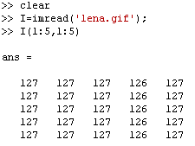
Reading an image in MATLAB
Image is represented in MATLAB in the form of Matrix
In MATLAB syntax of image reading is
imread(‘filename.filetype’)

Slide 6
Writing an image in MATLAB
‘imwrite’ command is used to write the image.
Syntax:
imwrite(‘filename.filetype’)

Slide 7
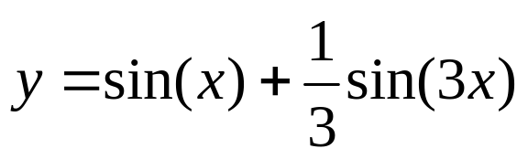
Image acquisition & Sampling
Sampling refers to the process of digitizing a continuous function
For Example:
Sampling an image requires that we consider the Nyquist criterion, when we consider an image as a continuous function of two variables, we wish to sample it to produce a digital image

Slide 8
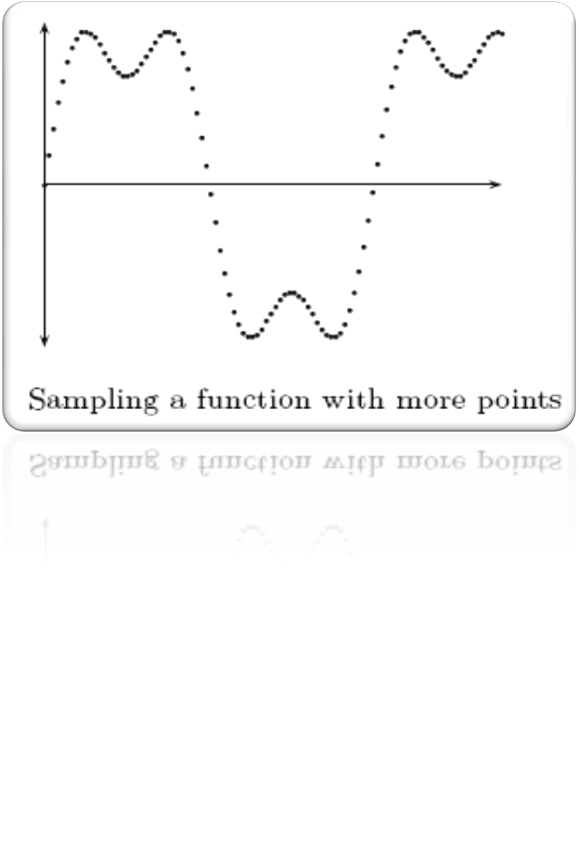
Image acquisition & Sampling

Slide 9
Type of image
There are three different types of image in MATLAB
Binary images
Intensity images
Indexed images

Slide 10
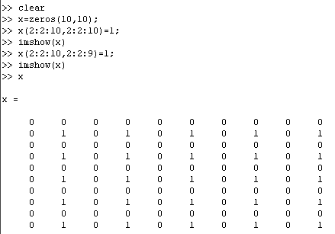

Binary Images
They are also called “ Black & White ” images , containing ‘1’ for white and ‘0’(zero) for black
MATLAB code

Slide 11
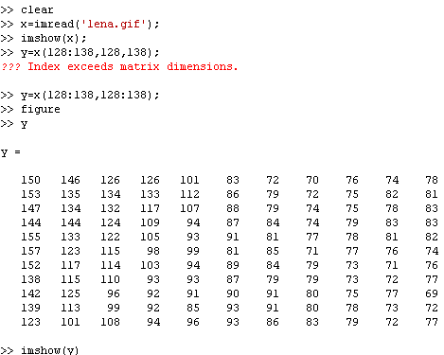
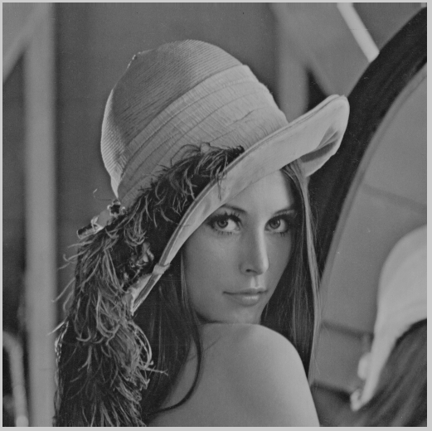
Intensity Images
They are also called ‘ Gray Scale images ’ , containging numbers in the range of 0 to 255

Slide 12
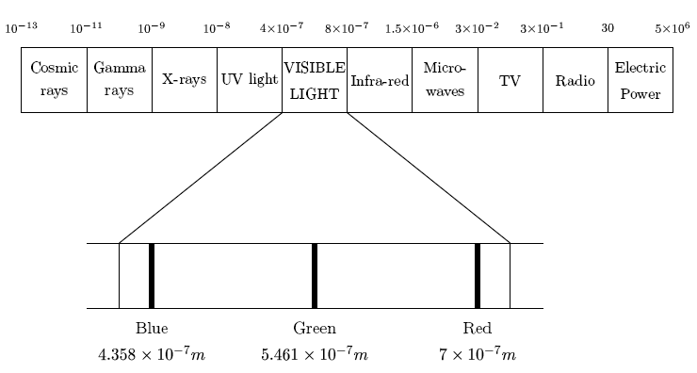
Indexed Images
These are the color images and also represented as ‘RGB image’.
In RGB Images there exist three indexed images.
First image contains all the red portion of the image, second green and third contains the blue portion.

Slide 13
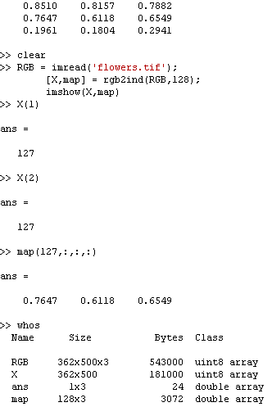
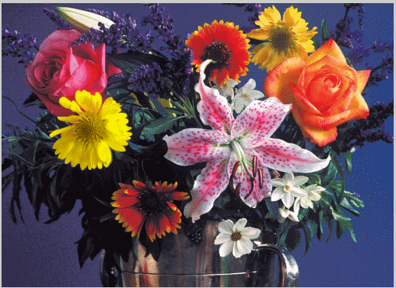
Indexed Images
MATLAB stores the RGB values of an indexed image as values of type double.

Slide 14
Image Type Conversion
RGB Image to Intensity Image (rgb2gray)
RGB Image to Indexed Image (rgb2ind)
RGB Image to Binary Image (im2bw)
Indexed Image to RGB Image (ind2rgb)
Indexed Image to Intensity Image (ind2gray)
Indexed Image to Binary Image (im2bw)
Intensity Image to Indexed Image (gray2ind)
Intensity Image to Binary Image (im2bw)
Intensity Image to RGB Image (gray2ind, ind2rgb)

Slide 15
Image Histogram
There are a number of ways to get statistical information about data in the image.
Image histogram is on such way.
An image histogram is a chart that shows the distribution of intensities in an image.
Each color level is represented as a point on x-axis and on y-axis is the number instances a color level repeats in the image.
Histogram may be view with imhist command.

Slide 16
Image Histogram
Sometimes all the important information in an image lies only in a small region of colors, hence it usually is difficult to extract information out of that image.
To balance the brightness level, we carryout an image processing operation termed histogram equalization.

Slide 17
Image Segmentation
In image processing useful pixels in the image are separated from the rest by a process called image segmentation.
Brightness Threshold and Edge detection are the two most common image segregation techniques.
In brightness threshold, all the pixels brighter than a specified brightness level are taken as 1 and rest are left 0.
In this way we get a binary image with useful image as 1 and unwanted as 0.

Slide 18
Image Segmentation
In edge detection special algorithms are used to detect edges of objects in the image.

Slide 19
Morphological Operations
These are image processing operations done on binary images based on certain morphologies or shapes
The value of each pixel in the output is based on the corresponding input pixel and its neighbors.
By choosing appropriately shaped neighbors one can construct an operation that is sensitive to a certain shape in the input image.

Slide 20
Application of Image Processing
BIOLOGICAL: automated systems for analysis of samples.
DEFENSE/INTELLIGENCE: enhancement and interpretation of images to find and track targets.
DOCUMENT PROCESSING: scanning, archiving, transmission.
FACTORY AUTOMATION: visual inspection of products.
MATERIALS TESTING: detection and quantification of cracks, impurities, etc.
MEDICAL: disease detection and monitoring, therapy/surgery planning

Slide 21


